Slide 1

Advanced Object-Oriented Design and Programming 2025
E-Commerce Application Development:
Emphasizing Object-Oriented Design, Design Patterns, and Secure Coding Practices
University of Essex Online
Payman Ghorbani
January 2026

Slide 2
Project Overview
GitHub link: https://github.com/pg25304/ecommerce-capstone-project/blob/master/test/test_strong_password_strategy.py
Scope:
Development of a scalable and secure e-commerce application as a University task.
Purpose:
Address challenges in user management, order processing, and inventory management through modular design and secure coding principles.

Slide 3
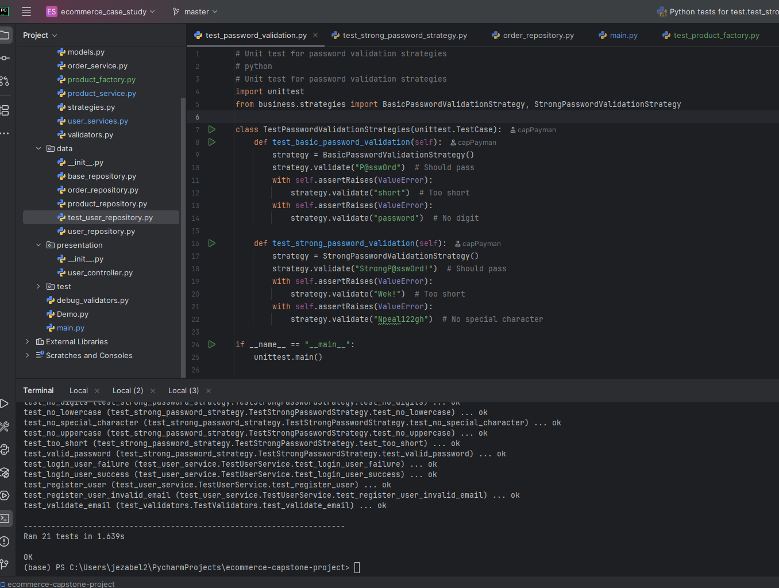
python -m unittest discover -s test -p "*.py" –v Before Starting
Notes:
Sanitizing input in Python refers to the process of cleaning and validating user-provided data to prevent potential security vulnerabilities, such as SQL injection or cross-site scripting (XSS).

Slide 4
Problem Statement and Objectives
Problem Statement:
Managing user authentication, processing orders, and maintaining secured operations are essential for modern e-commerce systems.
Objectives:
Demonstrate Object-Oriented Design Principles for maintainability.
Apply Design Patterns to achieve flexibility and scalability.
Ensure secure coding practices like input validation, authentication, and exception handling.
Test the application:
python -m unittest discover -s test -p "*.py" -v

Slide 5
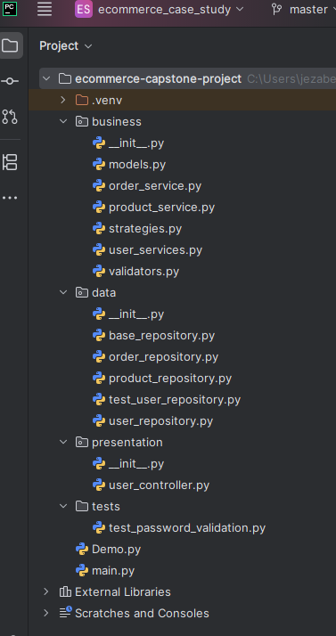
Design and System Architecture
(Monolithic layered App.)
Architectural Layers:
Presentation: Layer: Interfaces with
the user (e.g., UserController).
Business Layer: Solves business logic
(e.g., UserService, OrderService).
Data Layer: Manages storage
and retrieval (UserRepository).
Dependency’s flow:
Presentation ->Business ->Data

Slide 6
Object-Oriented Design Principles I
Encapsulation:
  Each class encapsulates its specific responsibilities, such as UserService handling user-related operations and OrderService managing order logic
Polymorphism:
  when multiple methods with the same name can handle different parameters. i.e. overloading save() and find() methods with different parameters in product_repository.py and order_repository.py
Notes:
Polymorphism is achieved through method overriding (when a subclass provides a different implementation of a method) or method overloading (when multiple methods with the same name can handle different parameters).

Slide 7
Object-Oriented Design Principles II
  Inheritance:
  BaseRepository.py is a parent class extended by repositories (UserRepository, OrderRepository).
Abstraction:
  Layers isolate specific concerns, such as data access, UI handling, and business logic.
  Making it easier to understand, maintain, and modify individual components without affecting the entire system.

Slide 8
Application of Design Patterns – Factory Method
Implementation: product_factory.py
Abstract Product: Product class with a get_details() method.
Concrete Products: DigitalProduct and PhysicalProduct inherit from Product.
Factory: A ProductFactory with a method to create objects based on input type (e.g., "digital", "physical").
Purpose: Simplify object creation by encapsulating logic; enhances flexibility and scalability.
Testing: Terminal:
Python main.py -> test the code (Factory method) from terminal
python -m unittest discover -s test -> verify the implementation.

Slide 9
Application of Design Patterns II
Structural Patterns:
  Dependency Injection: Example: Passing repositories and validation strategies into classes like UserService (user_services.py).
  Import from validators.py and strategies.py
Behavioural Patterns:
  Strategy Pattern: Provides flexibility for password validation (e.g., BasicPasswordValidationStrategy vs StrongPasswordValidationStrategy) in strategies.py
Notes:
Structural Patterns
Structural patterns deal with class composition and object relationships to create flexible and efficient design.

Slide 10
Secure Coding Practices
Input Validation: validators.py
validate_email() and validate_password() prevent invalid data entry.
sanitize_input() avoids injection attacks.
Authentication:
Secure password hashing with bcrypt (user_service.py)
Exception Handling:
Comprehensive error handling ensures fault tolerance (validators.py).
Notes:
Sanitizing input in Python refers to the process of cleaning and validating user-provided data to prevent potential security vulnerabilities, such as SQL injection or cross-site scripting (XSS).

Slide 11
Project Workflow Demo
1. User Registration:
Input email, password → Validation → Secure storage. Validtors.py
2. Login Validation:
User authentication with hashed passwords. User_service.py
3. Product and Order Management:
Adding products, managing stock, and processing orders. Product_service.py and order_service.py
Notes:
Sanitizing input in Python refers to the process of cleaning and validating user-provided data to prevent potential security vulnerabilities, such as SQL injection or cross-site scripting (XSS).

Slide 12
Real-World Challenges and Solutions
Challenge 1: Dynamic requirements for password validation.
  Solution: Implemented Strategy Pattern for validation flexibility (strategies.py).
Challenge 2: Complex repository interactions.
  Solution: Used BaseRepository for consistency and reusability (base_repository.py).
Challenge 3: Mitigation of common security risks.
  Solution: Input sanitization and secure authentication via bcrypt (user_service.py and validators.py).
Notes:
Sanitizing input in Python refers to the process of cleaning and validating user-provided data to prevent potential security vulnerabilities, such as SQL injection or cross-site scripting (XSS).

Slide 13
Testing and Preparation
Title: Unit Testing:
  Tested validation strategies, repositories, and services. Test_user_repository, test_password_validation
Thorough Debugging:
  Fixed edge case issues such as invalid input handling. Validators.py
Demo Environment Setup:
  Fully functional repositories tailored for production and testing. Demo.py
  Demonstration: Run “pytest –v” on Terminal of PyCharm – NEXT SLIDE
Notes:
Sanitizing input in Python refers to the process of cleaning and validating user-provided data to prevent potential security vulnerabilities, such as SQL injection or cross-site scripting (XSS).

Slide 14
Key Learnings
The importance of maintaining modular code for scalability.
Application of object-oriented principles in real-world projects.
Benefits of secure programming practices in minimizing vulnerabilities.
Notes:
Sanitizing input in Python refers to the process of cleaning and validating user-provided data to prevent potential security vulnerabilities, such as SQL injection or cross-site scripting (XSS).

Slide 15
Improvement
Improvement: Using Argon2 rather than bcrypt
It is memory-hard (resistant to GPU-based attacks).
Slows down brute-force, DDoS, attacks efficiently.
To catch the ValueError exception in my code and handle it gracefully, using a try...except block

Slide 16
Questions and Reflections
Open to questions about design, implementation, or future improvements.
Reflection: This project showcases the synergy of software engineering principles and real-world problem-solving.
Notes:
Sanitizing input in Python refers to the process of cleaning and validating user-provided data to prevent potential security vulnerabilities, such as SQL injection or cross-site scripting (XSS).

